Slide 1
A TALE IN EVERY FRAME: THE ART OF CRAFTING IMAGE CAPTIONS
Done By:
C.ASWINI CHOUDARI [192211442]
U.SUJALA REDDY[192211737]
A.SUJITHA REDDY[192211824]
Guided By:
DR.R.LATHA

Slide 2
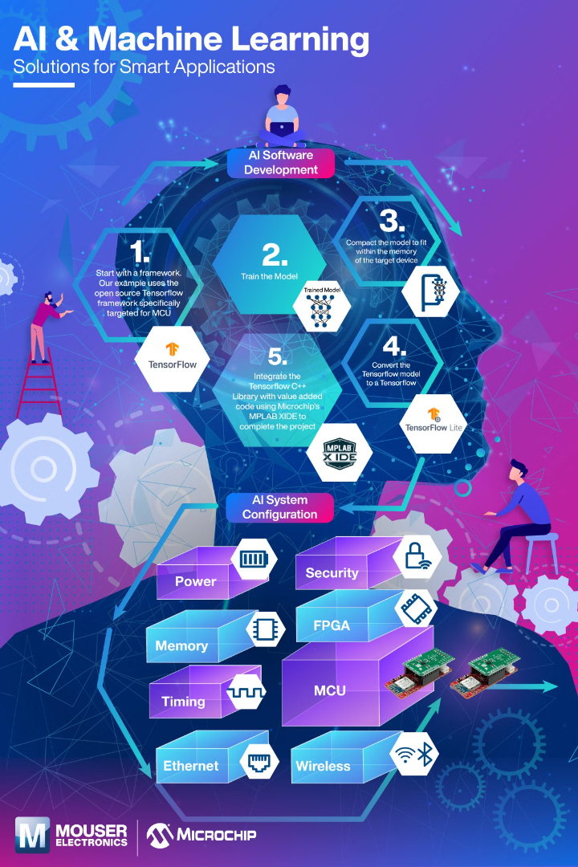
Introduction to Image Caption Generator
A caption generator is an AI tool that uses machine learning to analyze and describe the content of images in natural language, providing accurate and meaningful captions for visual content.

Slide 3
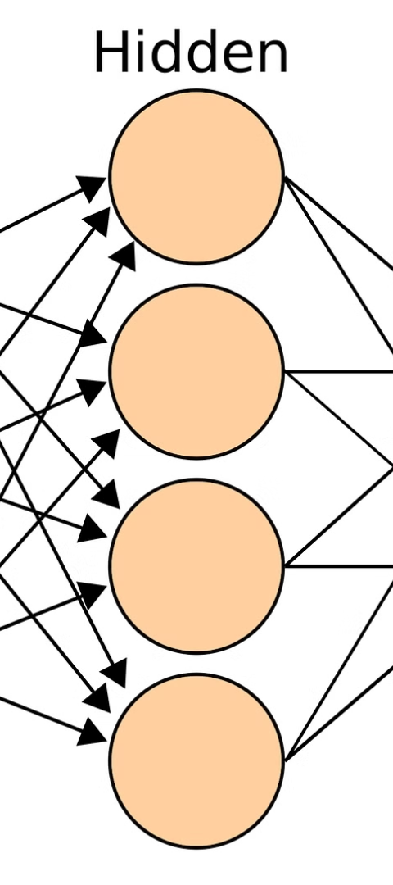



How it Works
Data Collection
Collect a wide variety of images to train the neural network.
Training
Feed the data into the neural network to enable it to learn and generate captions.
Caption Generation
Once trained, the network processes an image and generates a descriptive caption.

Slide 4
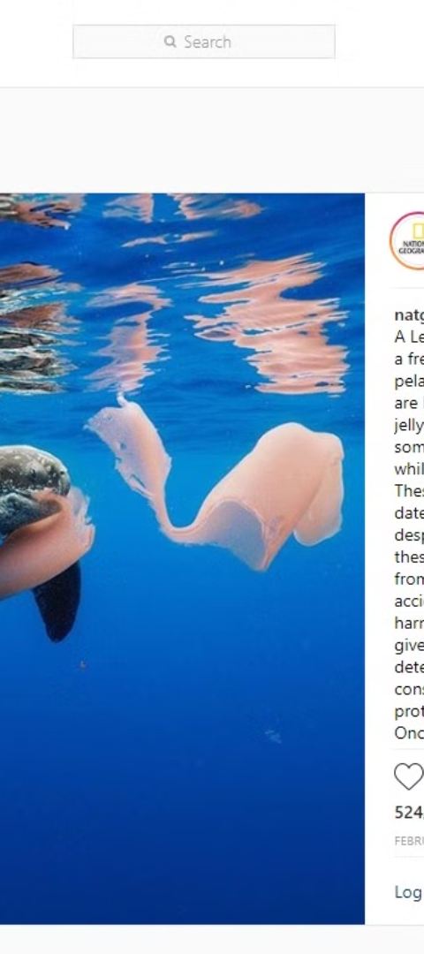
Importance of Accurate Image Captions
1
Accessibility
2
Search Engine Optimization
Provides valuable context for visually impaired individuals using screen readers.
Accurate captions improve SEO, making images more discoverable.
3
Enhanced User Experience
Clear captions improve engagement and understanding for all users.

Slide 5
Applications in Various Industries
Healthcare
Marketing
Education
Assisting medical professionals in analyzing and categorizing medical images.
Enhancing advertising campaigns with targeted and descriptive image captions.
Enabling the development of educational materials for visually impaired students.

Slide 6

Challenges in Image Caption Generation
1
Data Quality
Ensuring that training data is diverse and representative of real-world scenarios.
2
Contextual Understanding
Teaching the model to understand the nuanced and varied content of images.
3
Localization
Accurately identifying and describing specific elements within an image.

Slide 7

Future Developments and Trends
Improved Accuracy
Multi-Modal Integration
Ongoing advancements in AI are expected to enhance the accuracy and relevance of image captions.
Integration of multiple data types to create more comprehensive and meaningful captions.
Real-Time Captioning
Development of systems capable of generating captions in real time.

Slide 8
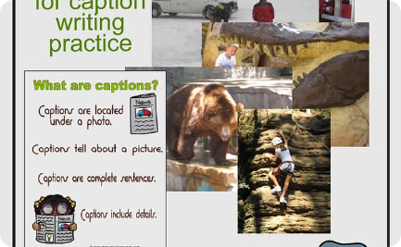

Case Studies and Success Stories
Journalism
Digital Marketing
Education
Improving the accessibility and relevance of news articles through image captions.
Driving engagement and conversions through targeted and compelling image captions.
Empowering inclusive and accessible educational content for diverse learners.

Slide 9




Conclusion and Key Takeaways
Innovation
Diversity
Impact
Future
Revolutionizing the understanding and utilization of visual content.
Enabling the inclusion of diverse individuals and communities through image captions.
Transforming industries and enhancing user experiences through accurate image captions.
Continuously evolving to meet the demands of dynamic visual content.

